Slide 1
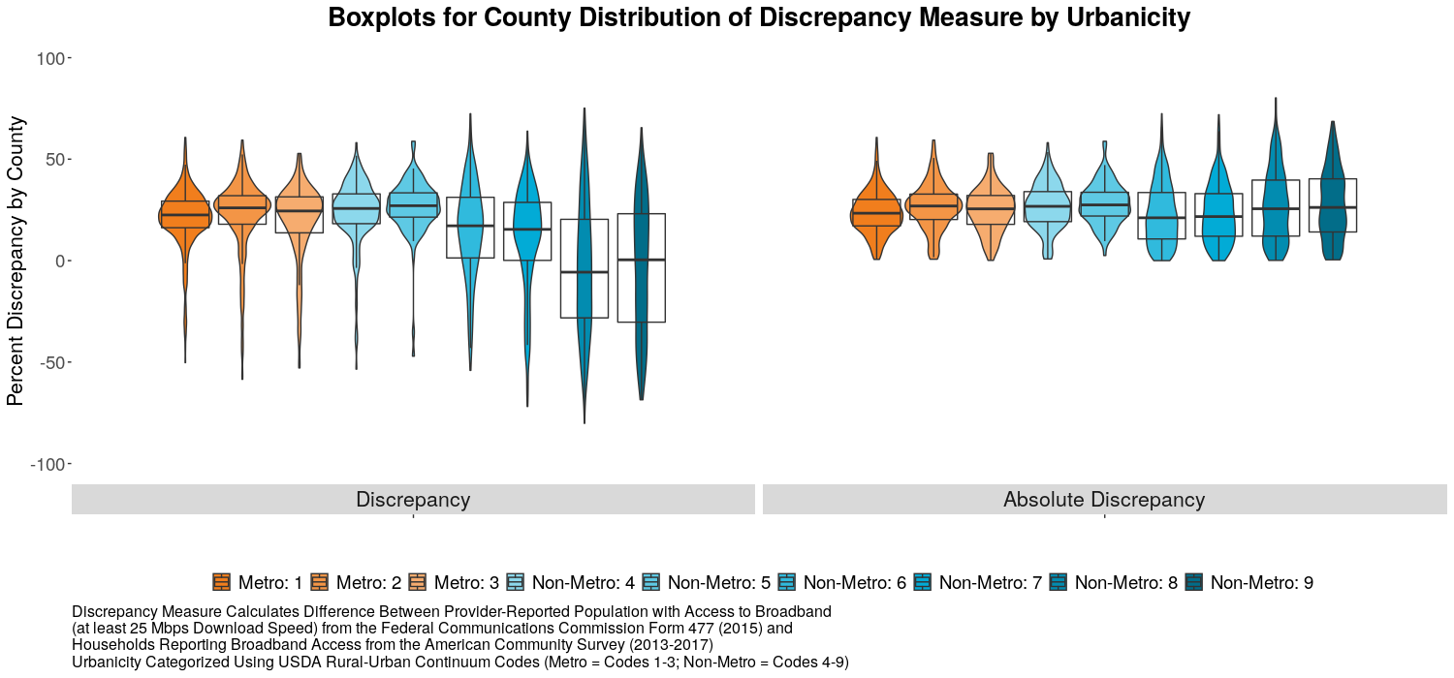
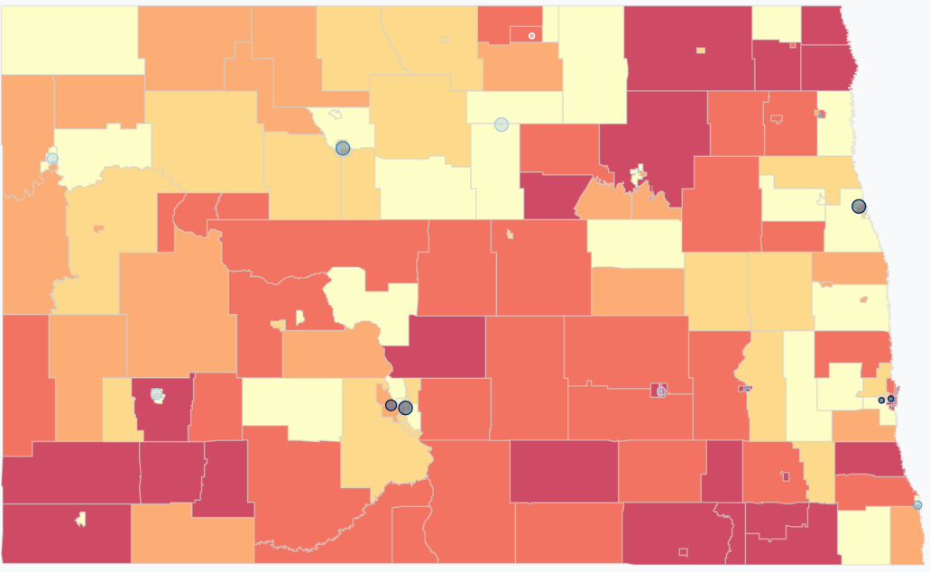
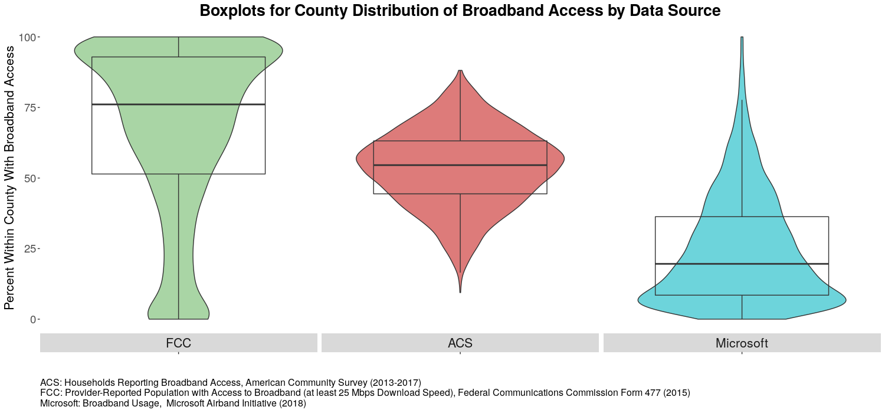
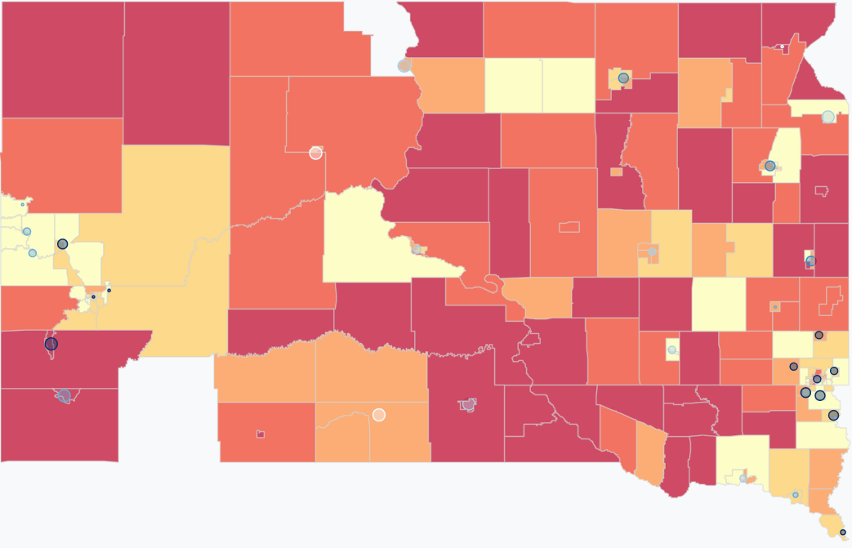
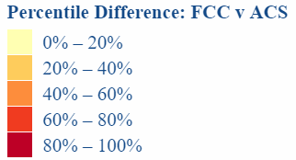
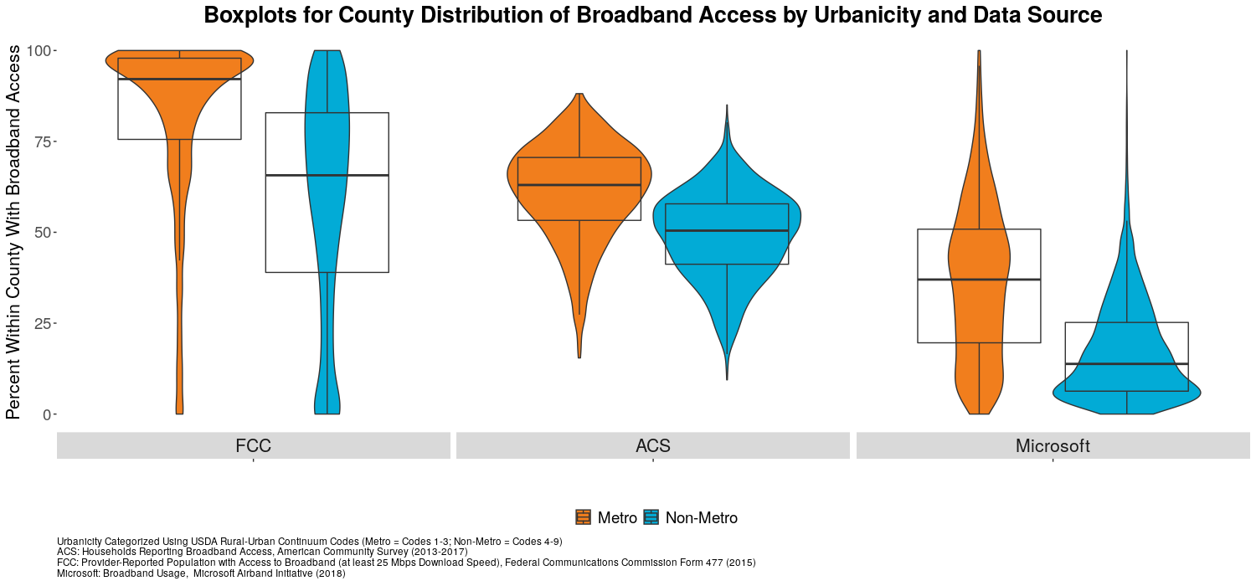
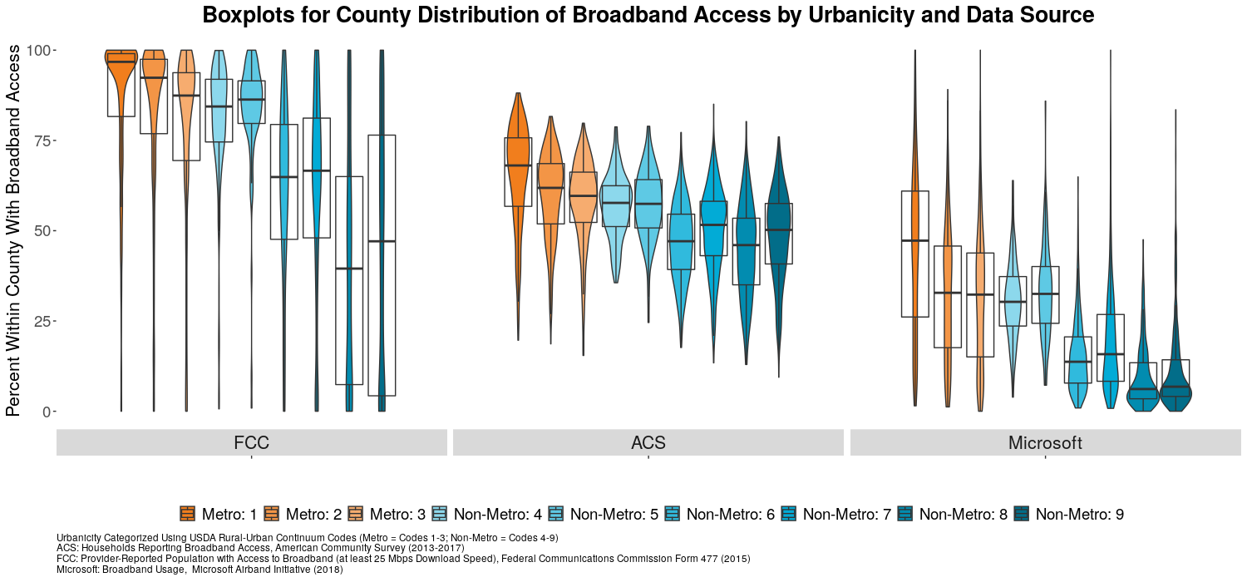
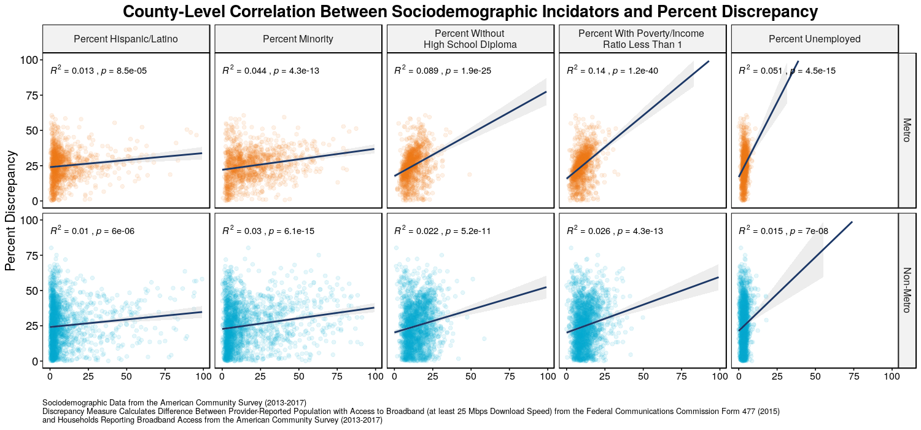


Broadband Data Validation:
Comparing U.S. Broadband Coverage
DSPG Team: Kat Savchyn (Georgetown University), Sarah McDonald (Marymount University),
Raghav Sawhney (Virginia Tech)
SDAD Team: Teja Pristavec, Josh Goldstein, Stephanie Shipp
SPONSOR: John Pender, Peter Hahn, Zachary Keeler, USDA Economic Research Service
Introduction
Does broadband development affect rural prosperity, as measured by changes in property values and quality of life indicators in rural communities?
Conducted a comprehensive literature review of value modeling consisting of factors other than broadband that shape property values. We found relevant environmental, neighborhood, structural, and locational attributes that influence property prices.
Explored methods of validating Federal Communications Commission (FCC) broadband data, using multiple data sources.
Data
FCC FORM 477
American Community Survey
BroadbandNow
Microsoft Airband
    Self-reported data from broadband providers, potentially introducing error if advertised coverage estimates are reported rather than actual estimates.
    If a census tract had just one subscriber, the entire census tract is assumed to have broadband.
Claims that broadband is not available to 25 million Americans.
Table B28002: Presence and Types of Internet Subscriptions in Household for the 2013-2017 data specific to broadband.
Self-reported data from households, but does not include group quarters.
Online search engine which lists information for broadband availability on the zip code and city level.
Provides information on:
        number of providers,
        maximum and average upload and download speeds
        change in broadband speeds over time.
Finds that 163 million Americans do not use the internet at 25 mbps, or broadband speed.
Analyzing its servers logs when electronic devices downloaded Microsoft Windows and/or Office updates, as well as when devices used the Microsoft’s Bing search engine and Xbox gaming consoles.
Validation Methodology
Boxplots for County Distribution of Discrepancy Measure by Urbanicity
    Scraped and aggregated data at the county, city, census tract, and block group levels to observe differences in coverage.
    Developed FCC coverage metric using a threshold of 25 mbps download speed and supplemented with American Community Survey data to determine % of population with broadband access. The absolute difference between this metric and other data sources identifies level of discrepancy:
      1) ACS 007 access to broadband (excluding cellular and satellite)
        2) FCC internet service connections of at least 10 mbps (bins) [block group, census tract]
        3) Microsoft usage percentage [county]
        4) BroadbandNow coverage [city]
        Examined data by USDA-specified Rural-Urban Continuum Codes (RUCC). RUCC codes distinguish metropolitan counties by the population size of their metro area, and nonmetropolitan counties by degree of urbanization and adjacency to a metro area.
Discrepancy
Absolute Discrepancy
Case Study
Findings
Broadband coverage discrepancy map for North Dakota (ND) and South Dakota (SD) at block group level.
Boxplots for County Distribution of Broadband Access by Data Source
Explored the broadband coverage discrepancy between FCC and ACS data in ND and SD to understand the effect of state boundaries and policies on broadband availability.
We notice higher coverage discrepancy in the more rural parts of ND and SD.
The southwest section of ND is majority urban compared to the rest of the state, and we can see a difference in broadband coverage across the northeast portion of SD, which is more rural.
ND is a largely rural state that experienced a surge in broadband availability mainly due to the Broadband Technology Opportunities Program (BTOP), as well as a large-scale introduction of rural cooperatives (co-ops) that are made up of local service providers in the area.
FCC
ACS
Microsoft
FCC
ACS
Microsoft
Boxplots for County Distribution of Broadband Access
by Metro/Non-Metro Areas & Data Source
Discussion & Further Research
Findings: FCC, ACS, and Microsoft Airband data give very inconsistent estimates of broadband accessibility. However, they all estimate lower coverage in rural areas compared to urban areas.
Next steps: Explore the relationship between percent discrepancy and sociodemographic factors for counties by urbanicity. We provide our preliminary exploration of discrepancy and sociodemographic factors correlations below. Sociodemographic factors are more likely to influence discrepancies in metro than non-metro areas.
We use FCC, ACS, and Microsoft data to obtain model-based broadband access predictions based on sociodemographic information (e.g. urbanicity, unemployment).
FCC
ACS
Microsoft
Boxplots for County Distribution of Broadband Access by Urbanicity & Data Source
County-level Correlation between Sociodemographic Indicators & Percent Discrepancy
FCC
ACS
Microsoft
http://bband.policy-analytics.net/
Notes:
e

